Slide 1

Demo presentation
Matyas molnar
Week 8
Github : green-fox-academy/matyoo111
Linkedin: https://www.linkedin.com/in/molnarmatyas/

Slide 2
Content of presentation
Introduction
ToDo application task and result
ToDo application coding
Conclusion

Slide 3




Introduction
Mathematics and Philosophy at the University of York
Water polo
Philosophy of Science at the London School of Economics
Lifeguarding
Business Developer at FriendlyScore
FinTech Research Analyst Intern at McKinsey and Company

Slide 4
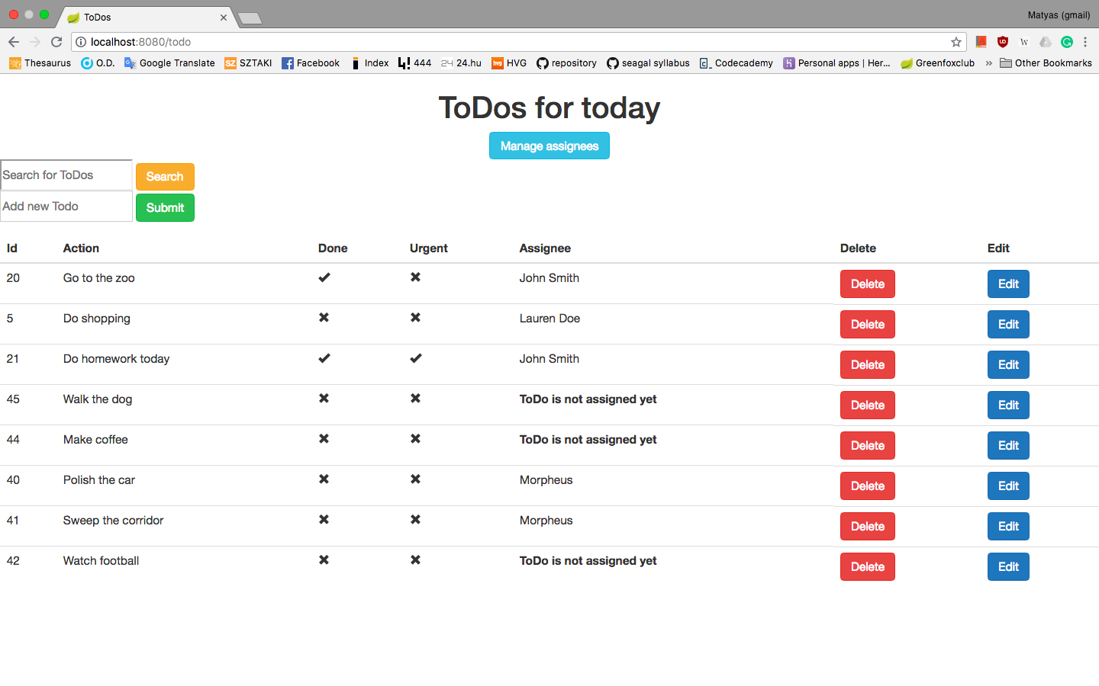
Task:

Slide 5
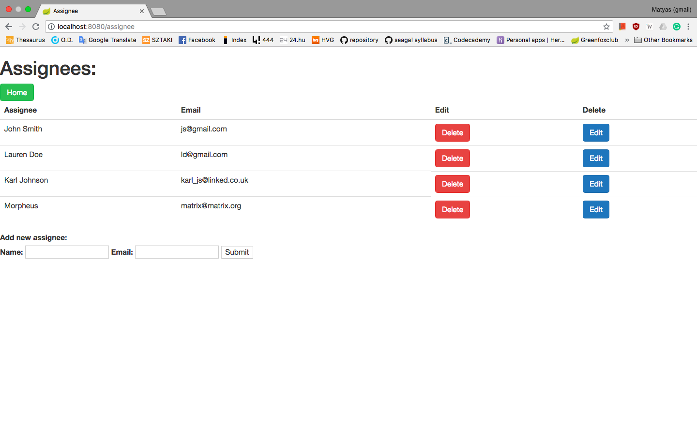

Slide 6
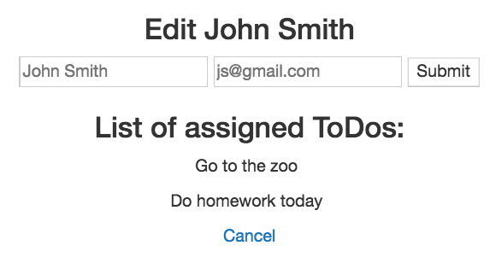
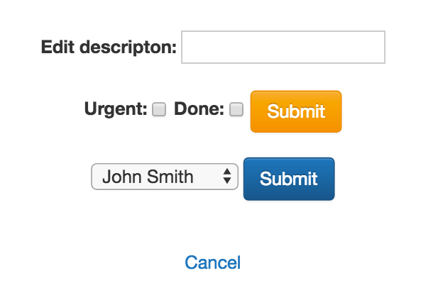
Functions

Slide 7
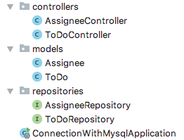

Folder structure for coding

Slide 8
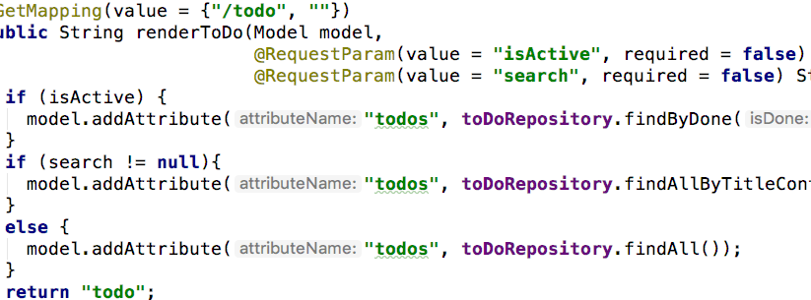
@Getmapping for mainpage

Slide 9
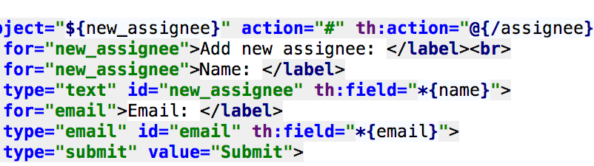
Set new object in thymeleaf

Slide 10
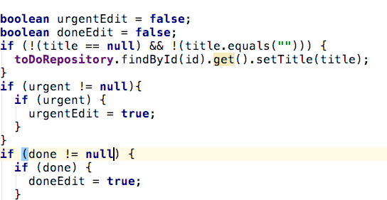
Tricky booleans

Slide 11
Conclusion
Naming is very important for smooth running
Better to work in more packages and classes
Error handling should be prioritized due to @Repositories and SQL

Slide 12
Thank you for watching!
Matyas molnar
Github : green-fox-academy/matyoo111
Linkedin : https://www.linkedin.com/in/molnarmatyas/

